Slide 1

Conditional GAN – Week 8
Ahsan Lohdi, Yang An
Technical University of Munich
Department of Informatics
Computer Vision Group
Garching, 18. June 2019

Slide 2
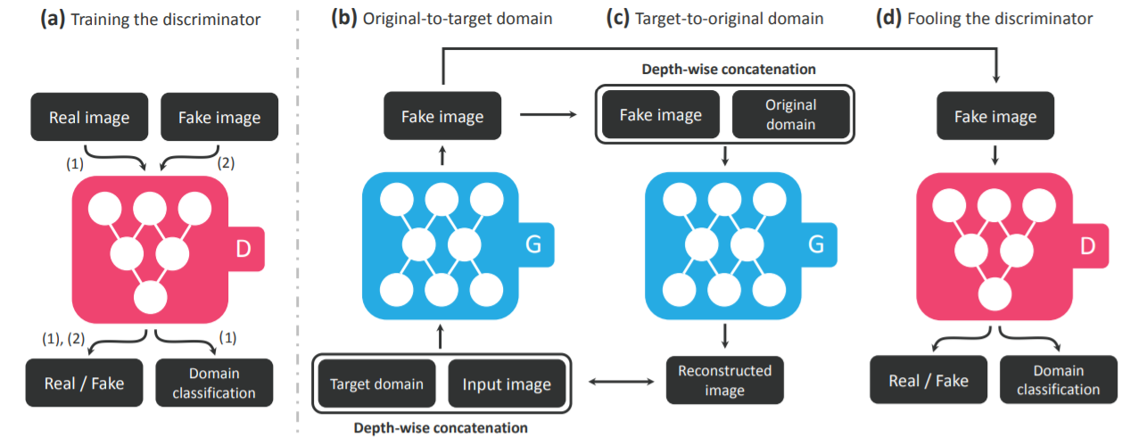
Recap - StarGAN
StarGAN works similar the way we wanted to modify CycleGAN. It extends the RGB channels with a one-hot-encoded channel. Moreover the discriminator is extended to do domain classification as well.

Slide 3
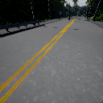
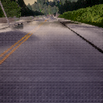
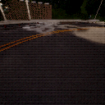
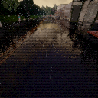
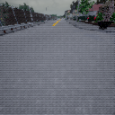
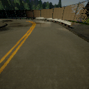
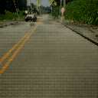
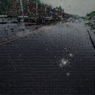
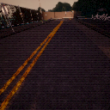
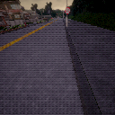
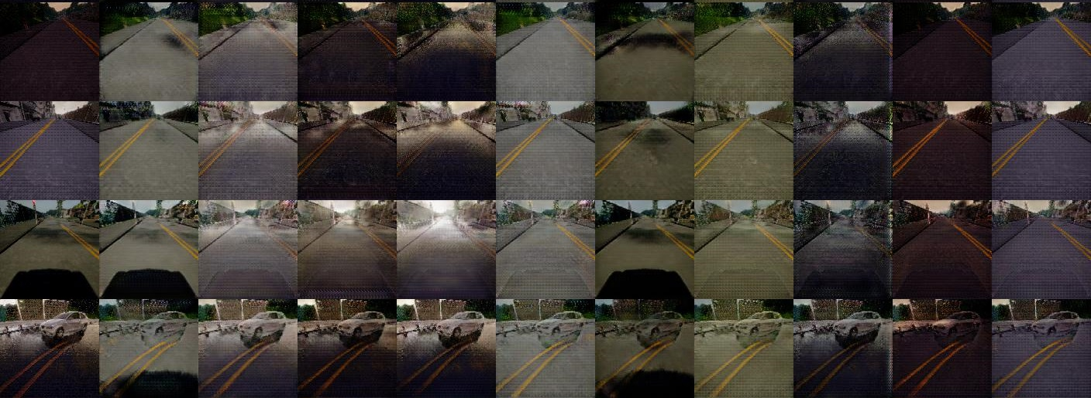
Recap - Results on simulated Dataset
Desired
Domain
Source
Image

Slide 4
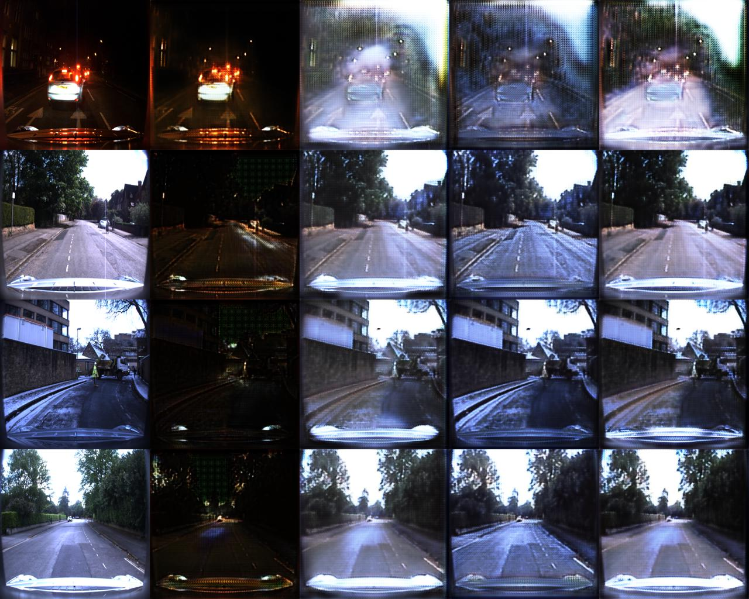
Recap - Results
4000 images
200000 Iterations
All trained models available on Gitlab

Slide 5
What we did
Extended StarGAN to be continuous. From now on refered as cStarGAN
Instead of giving the generator a target class (in the form of a one-hot-encoded vector) it gets a continuous target value
Trained cStarGAN on a new dataset – LOPC
Tested cStarGAN to create images with target values that are seen in the training dataset as well as unseen ones

Slide 6
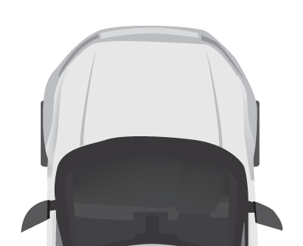

LOPC Dataset (1/2)
LOPC Dataset consists of simluated (CARLA) images. This time the weather conditions are all the same. The differences are the camera positions within the car
-1m
0m
1m

Slide 7
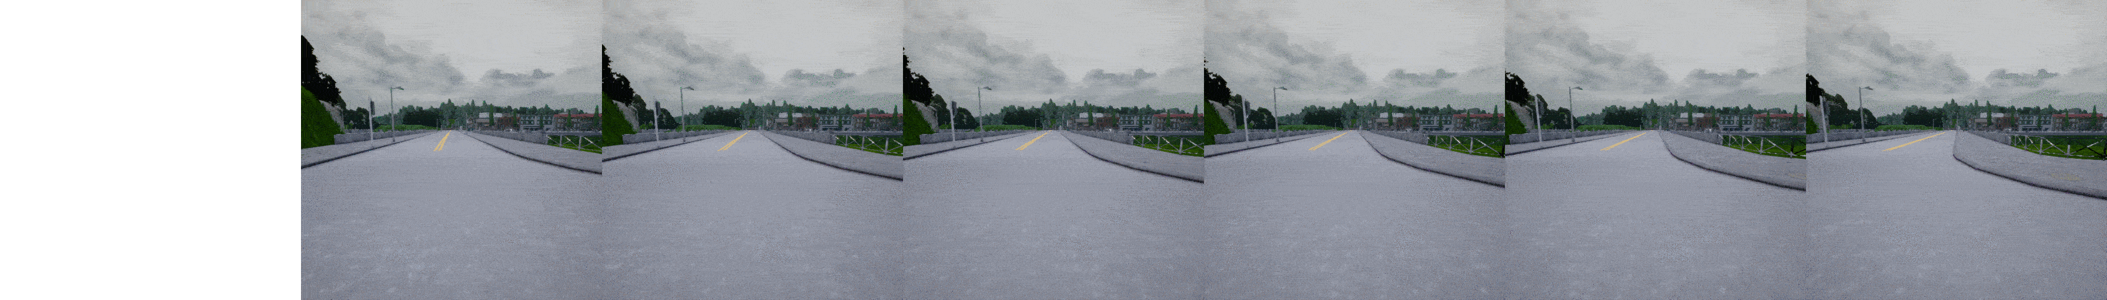
LOPC Dataset (2/2)
some example images
-1.3m | -0.3m | 0m | 0.5m | 1m | 2m

Slide 8
cStarGAN
During training, the generator should generate images with random target values between -1.3 and 2.0
Original Value
Regression
(MSE Loss)
Continuous target value
Regression
(MSE Loss)

Slide 9
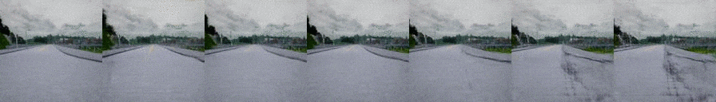
Results on seen values during training
Ground truth
Generated
Input image | -1.3m | -0.3m | 0m | 0.5m | 1m | 2m

Slide 10
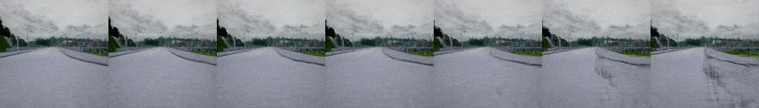
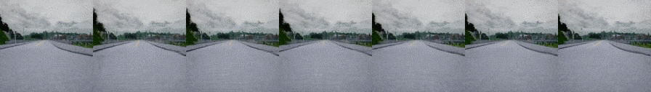
Results on unseen values during training
seen
unseen
unseen (out of range)
Input image | 0m | 0.5m | 1.0m | 1.5m | 2.0m | 2.5m
Input image | -1.7m | -1.3m | -1.0m | -0.7m | -0.3m | 0m

Slide 11
Results on unseen values with smaller step size
seen
unseen
Input image | -1.3m | -1.2m | -1.1m | -1.0m | -0.9m | -0.8m | -0.7m
 | -0.6m | -0.5m | -0.4m | -0.3m | -0.2m | -0.1m | 0m

Slide 12
Conclusion
Proof of Concept: It works
Results are mediocre, some values work well, others not so
Similar camera positions looks almost the same (e.g. 1m and 2m)
Model has problems to generate a fake pedestrian way
If Input image is from the same camera as our target value, the generated image is quite good
For unseen values, the model generates an image closest to a known value or sometimes mixes two values together
The model „memorizes“ the images on the known values

Slide 13
To Do
Idk

